Slide 1

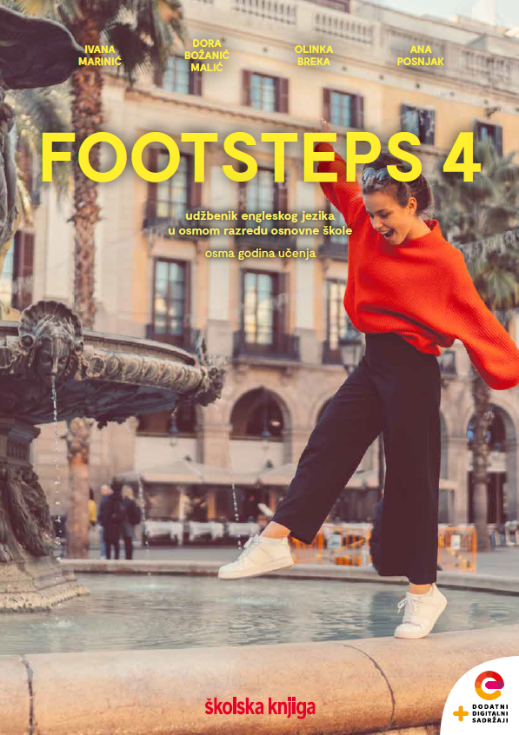

UNIT 7; Choices
Lesson 3; I want to…

Slide 2
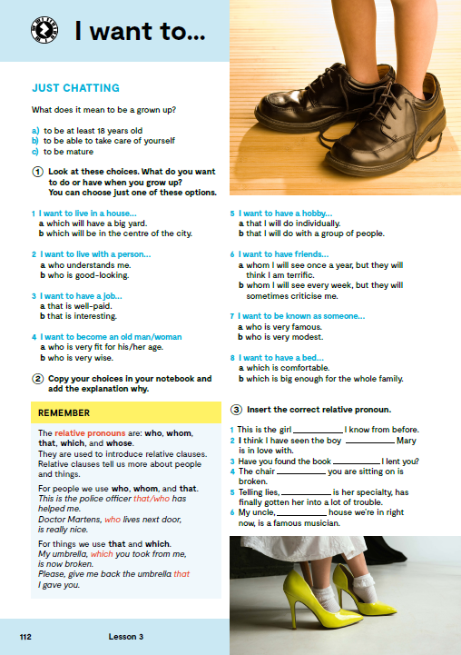
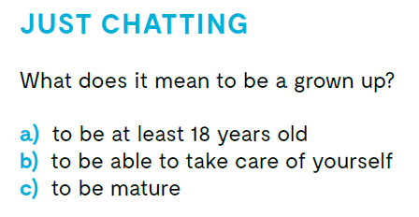

Slide 3
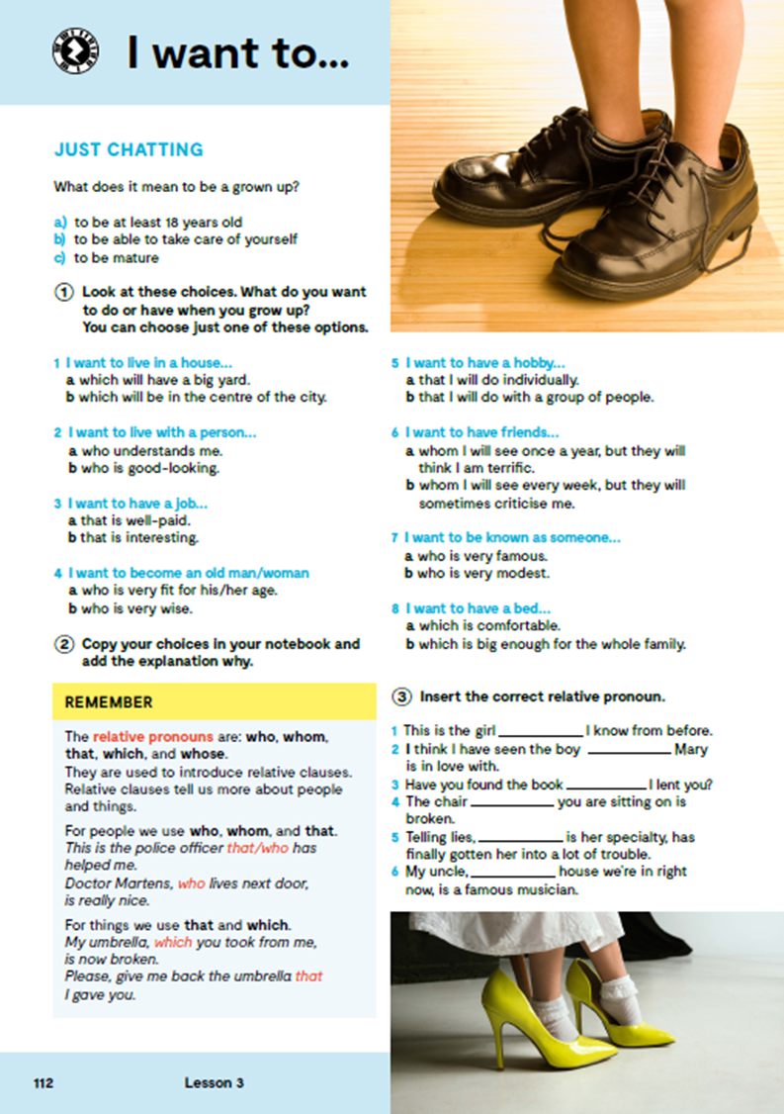
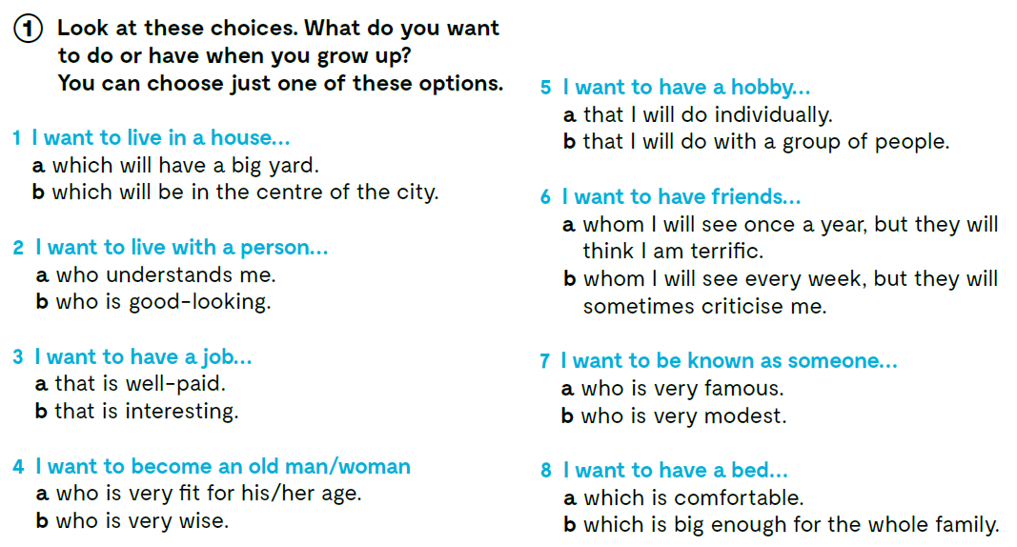


Slide 4
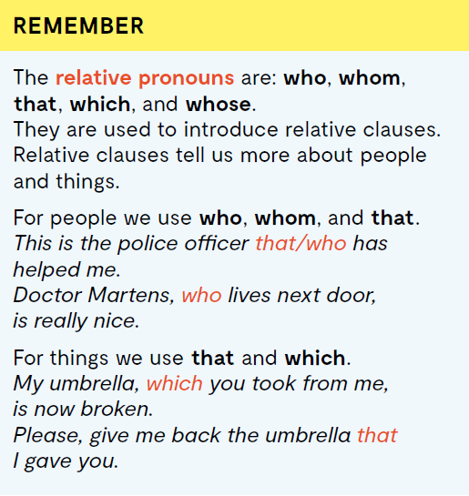
Odnosne zamjenice u engleskom jeziku su: who, whom, that, which i whose. Njih koristimo u odnosnim rečenicama, kada želimo dati više informacija o ljudima ili stvarima.
Kad govorimo o ljudima koristimo who, whom i that.
This is the police officer that/who has helped me.
Doctor Martens, who lives next door, is really nice.
Kad govorimo o predmetima koristimo that i which.
My umbrella, which you took from me, is now broken.
Please, give me back the umbrella that I gave you.
Whose koristimo kada govorimo o vlasništvu osoba, životinja ili stvari.
Whom koristimo umjesto who, ali samo kada je who u ulozi objekta odnosne rečenice.

Slide 5

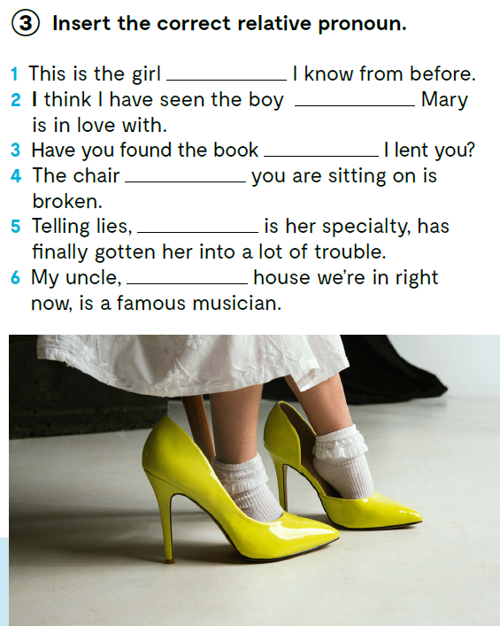
who/that
who/that
which/that
which/that
which
whose
Check what you have learnt. https://learningapps.org/watch?v=pqz3fwk9321

Slide 6
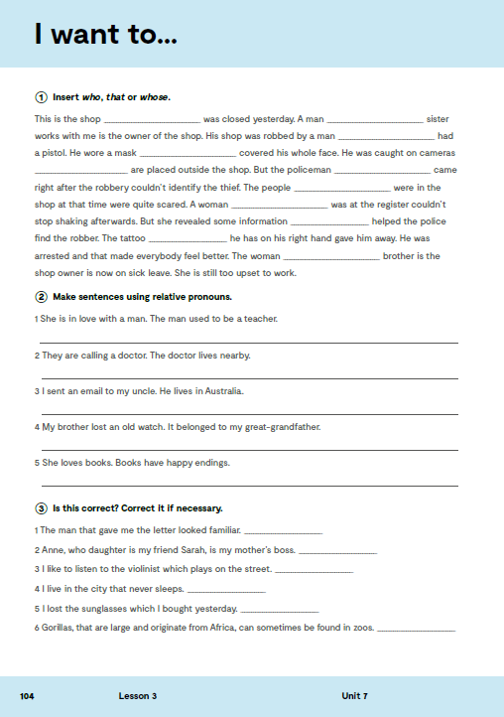
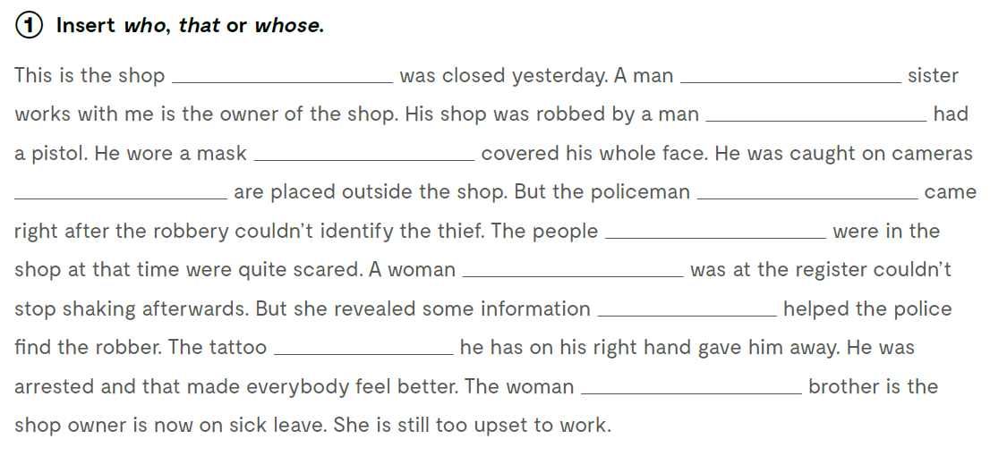
workbook, page 104.
that
whose
who
that
that
who
who
who
that
that
whose

Slide 7
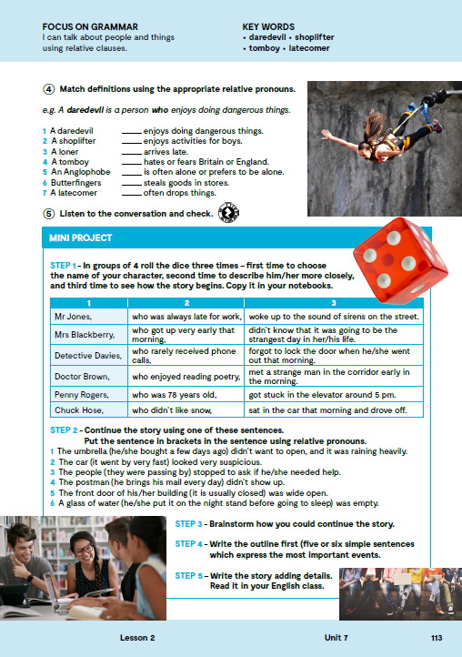
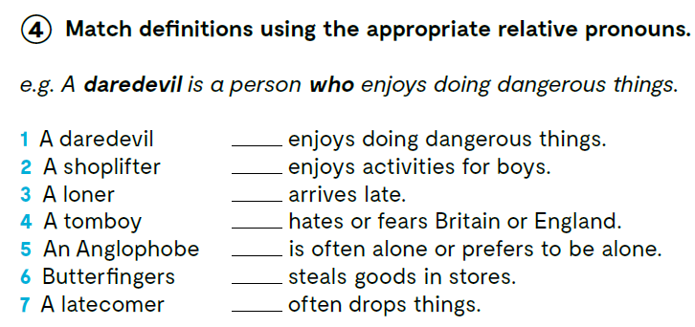


https://www.e-sfera.hr/dodatni-digitalni-sadrzaji/4e3d1a9c-c3e3-4f74-aeca-e1d334a4c9eb/assets/audio/28_unit_7__lesson_3__exercise_5.mp3
2 A shoplifter is a person who steals goods in stores.
3 A loner is a person who is often alone or prefers to be alone.
4 A tomboy is a person who enjoys activities for boys.
5 An Anglophone is a person who hates or fears Britain or England.
6 Butterfingers is a person who often drops things.
7 A latecomer is a person who arrives late.
Check what you have learnt https://www.bookwidgets.com/play/GCAUZGJ

Slide 8
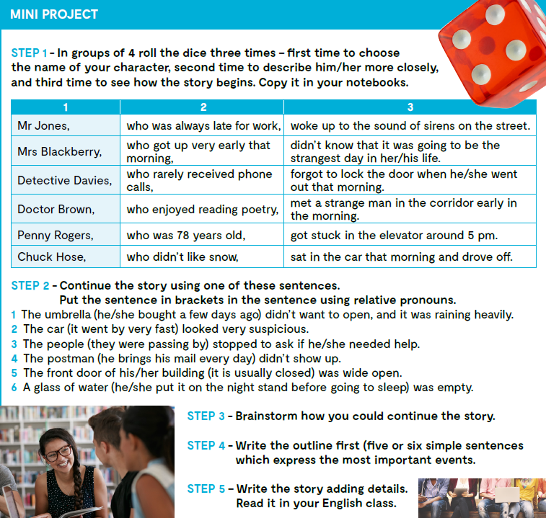
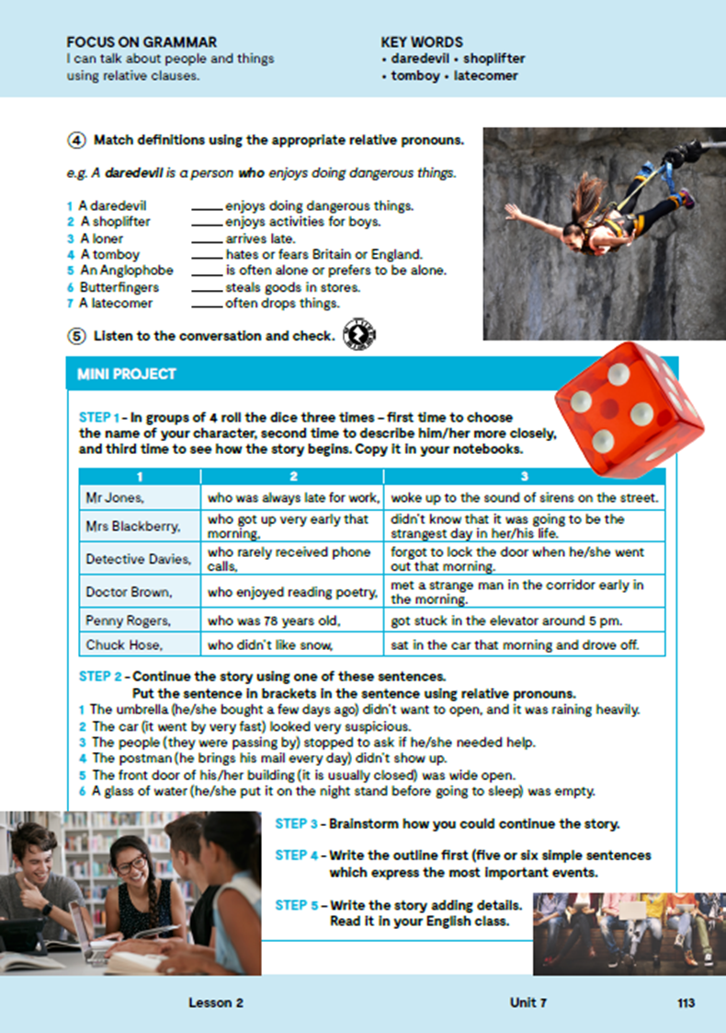

Slide 9

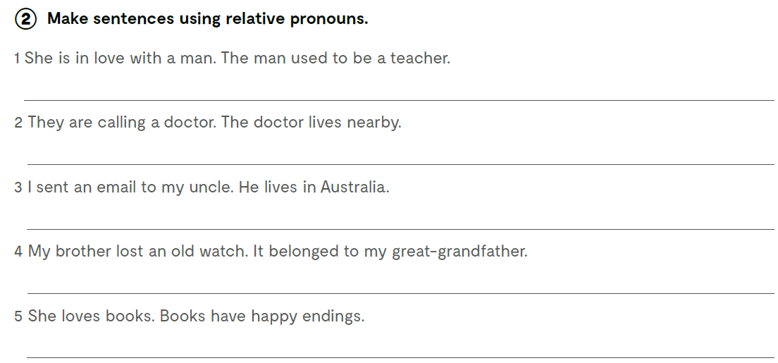
workbook, page 104.
She is in love with a man who used to be a teacher.
They are calling a doctor who lives nearby.
I sent an email to my uncle who lives in Australia.
My brother lost an old watch that belonged to my great-grandfather.
She loves books that have happy endings.

Slide 10
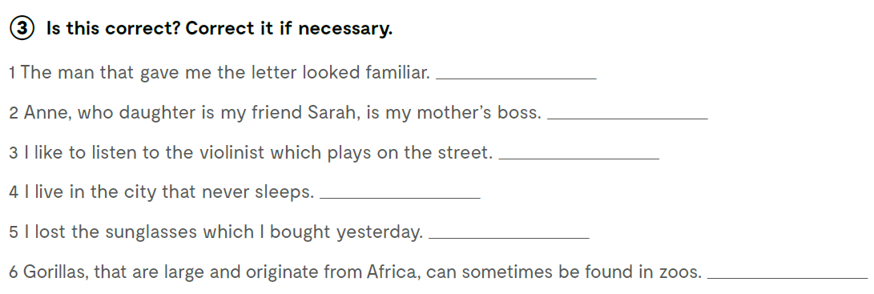




that/who
whose
who
which

